Slide 1


SI 618 Project 1 Sales Analytics for Fashion Products on Amazon by Using PySpark
Yonnie Chan
yonniech
October 23, 2022
Notes:
My name is Yonnie Chan
The topic of my project 1 is

Slide 2

Motivation
Online apparel and accessory sales in the United States are expected to surpass $118 billion in 2019, according to eMarketer, making it the largest product category by e-commerce sales (eMarketer, "The State of US Apparel Shopping in Five Charts", April 2018).
Discover secret to become a top seller on Amazon
Notes:
Amazon is the largest online platform in the US
In this project, I intend to analyze various aspects of sales: top selling in this category, how top-sellers are winning on Amazon, and figuring out the key factors to becoming a top-seller. I believe it would be helpful for third-party brands and retailers or those who are in E-commerce industries to improve their sales on Amazon

Slide 3
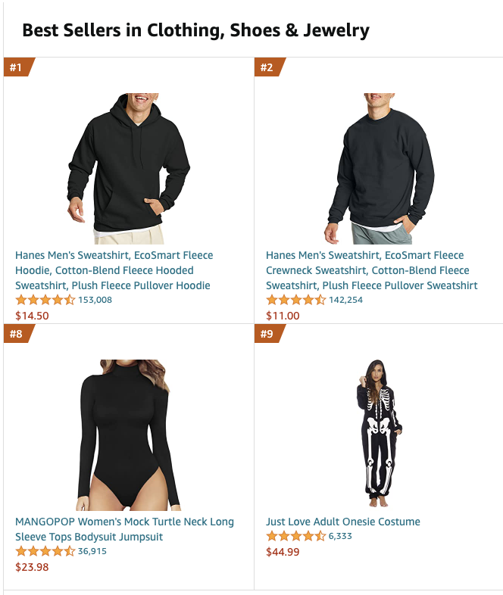
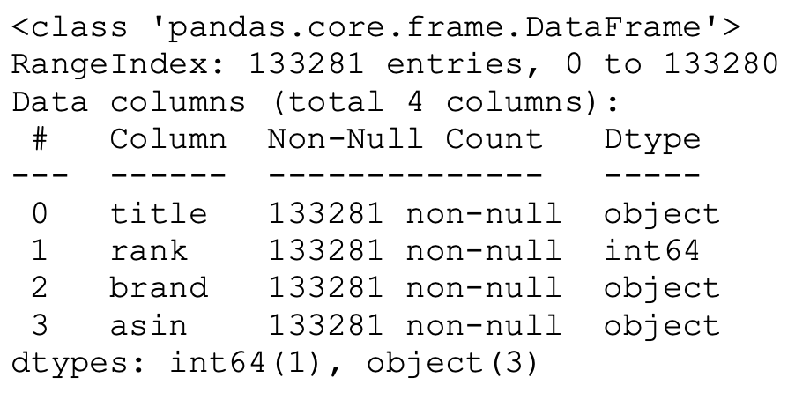
Dataset
Products Meta Data
Total Records Count:
2,685,059.
Amazon review data (2018) (https://jmcauley.ucsd.edu/data/amazon_v2/index.html)
Notes:
For this project, I had access to two different datasets on Amazon review data
I kept only the necessary variables that I’m interested in

Slide 4




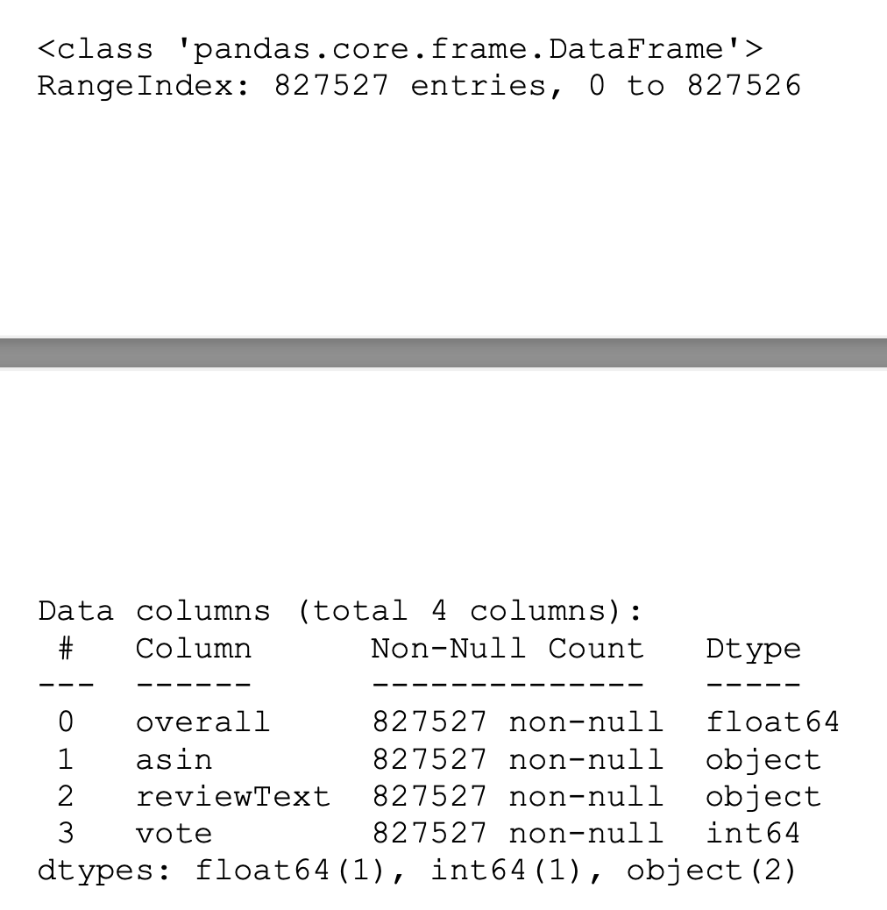


Dataset
Reviews Data
Total Records Count: 32,292,099.
Amazon review data (2018) (https://jmcauley.ucsd.edu/data/amazon_v2/index.html)
Notes:
Next, I join two datasets on their sharing columns obtain a completed dataset.

Slide 5

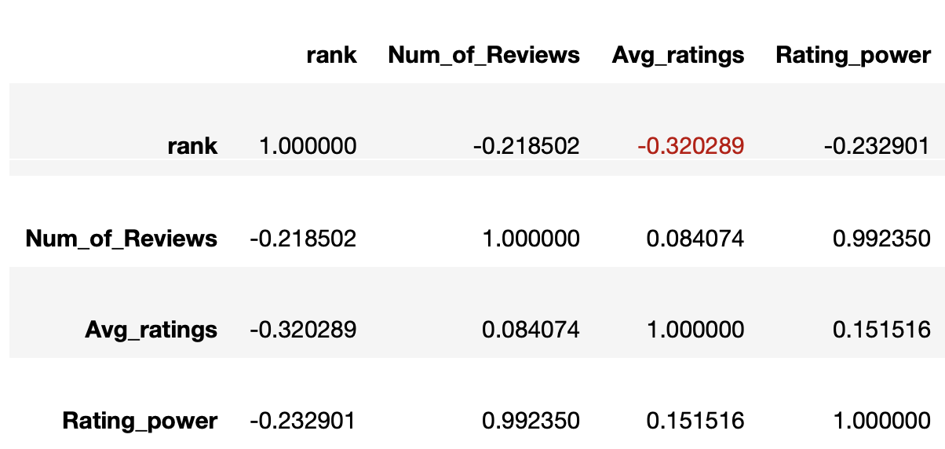
Analysis and Visualization
Correlation matrix
Whether Num_of_Reviews, Avg_ratings, and Rating_power affect the product ranking, and find the top products
Notes:
make a correlation analysis
Rating_power (Num_of_Reviews*Avg_ratings)
The correlation coefficient between rank and Avg_ratings is the largest, which means the average ratings of the product could affect the rank.

Slide 6
Analysis and Visualization
Rank vs Avg_ratings
Whether Num_of_Reviews, Avg_ratings, and Rating_power affect the product ranking, and find the top products
Notes:
I generated a histogram for Avg_ratings and rank to decide the range of ranking that have the most representative data.

Slide 7
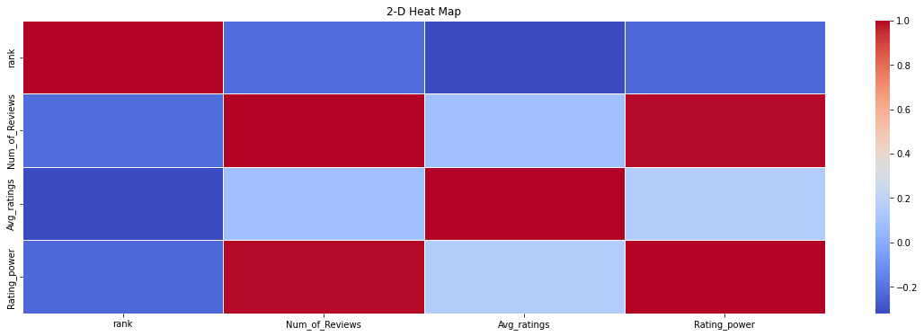
Analysis and Visualization
Rank vs Avg_ratings

